Slide 1
NETWORK
TECHNOLOGY
Chanchian Armin Andrei

Slide 2
A network is a group of two or more computers or other electronic devices that are interconnected for the purpose of exchanging data and sharing resources.
Definition: Network

Slide 3
TYPE OF NETWORKS
Based on scale
Based on transmission
LAN (Local Area Network)
MAN (Metropolitan Area Network)
WAN (Wide Area Network)
PAN (Personal Area Network)
VPN (Virtual Private Network)
Point to Point
Multi-point

Slide 4
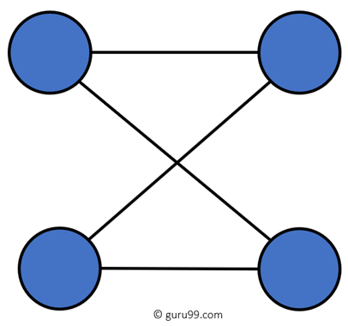
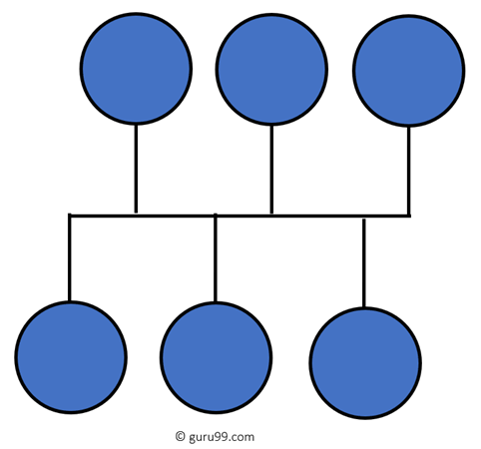
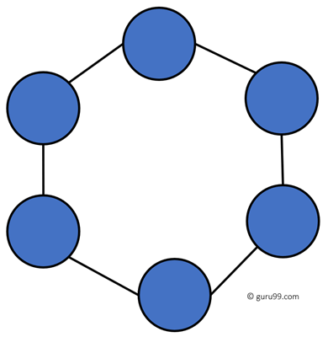
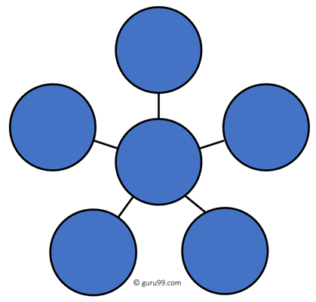
NETWORK TOPOLOGY
P2P
Ring
Bus
Star
Uses a single cable which connects all the included nodes
All the computers connect with the help of a hub
The network consists of a direct link between two computers
Every device has exactly two neighboring devices for communication purpose

Slide 5
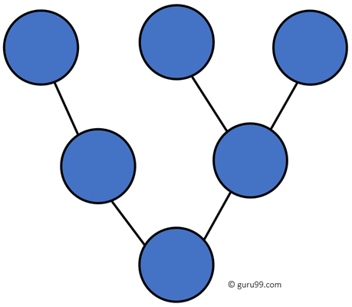
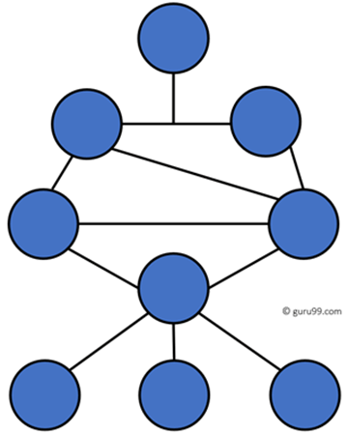
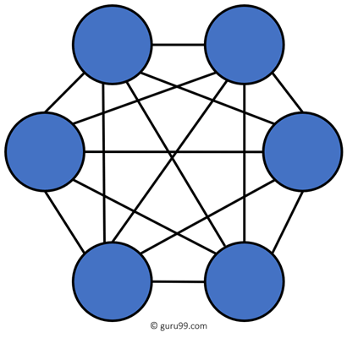
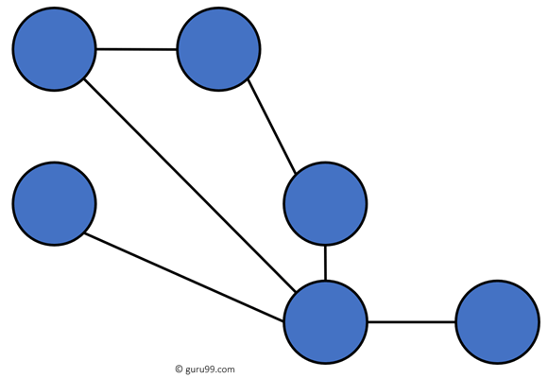
NETWORK TOPOLOGY
Hybrid Topology
Mesh
Tree
Tree topologies have a root node, and all other nodes are connected which forming a hierarchy.
The mesh topology has a unique network design in which each computer on the network connects to every other.
Hybrid topology combines two or more topologies

Slide 6

NETWORK SERVERS

Slide 7


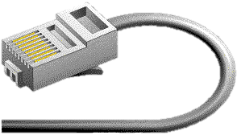
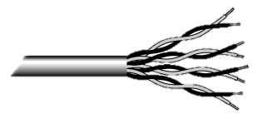


NETWORK LINKS
WIRED
WIRELESS
Coaxial cable is widely used for cable television systems, office buildings, and other work-sites for local area networks.
Twisted pair cabling is used for wired Ethernet and other standards.
An optical fiber is a glass fiber. It carries pulses of light that represent data via lasers and optical amplifiers.
Terrestrial microwave
Communications satellites
Cellular networks
Radio and spread spectrum technologies

Slide 8
WHAT IS A PROTOCOL?
A protocol is a set of rules that governs the communications between computers on a network. In order for two computers to talk to each other, they must be speaking the same language. Many different types of network protocols and standards are required to ensure that your computer (no matter which operating system, network card, or application you are using) can communicate with another computer located anywhere, worldwide .

Slide 9
Types of protocols (1/3)
Transmission Control Protocol
Internet Protocol
User Datagram Protocol
TCP is a popular communication protocol which is used for communicating over a network. It divides any message into series of packets that are sent from source to destination and there it gets reassembled at the destination.
IP is designed explicitly as addressing protocol. It is mostly used with TCP. The IP addresses in packets help in routing them through different nodes in a network until it reaches the destination system. TCP/IP is the most popular protocol connecting the networks.
UDP is a substitute communication protocol to Transmission Control Protocol implemented primarily for creating loss-tolerating and low-latency linking between different applications.

Slide 10
Types of protocols (2/3)
Hyper Text Transfer Protocol (Secure)
Simple mail transport Protocol
File Transfer Protocol
Telnet
HTTP is designed for transferring a hypertext among two or more systems. It works on a client-server model, most of the data sharing over the web are done through using HTTP. The transfer can be done in an encrypted format
Telnet is a set of rules designed for connecting one system with another. The connecting process here is termed as remote login. The system which requests for connection is the local computer, and the system which accepts the connection is the remote computer.
SMTP is designed to send and distribute outgoing E-Mail.
FTP allows users to transfer files from one machine to another. Types of files may include program files, multimedia files, text files, and documents, etc.

Slide 11
Types of protocols (3/3)
Domain Name System
Dynamic Host Configuration Protocol
DHCP can automatically assign Internet addresses to computers and users.
DNS translates network address (such as IP addresses) into terms understood by humans (such as Domain Names) and vice-versa.

Slide 12
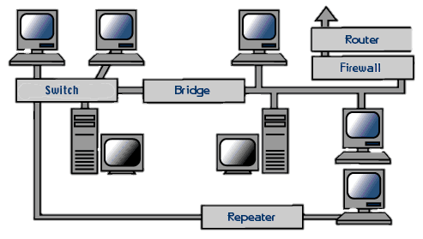
NETWORK NODES
— Network interfaces
— Repeaters and hubs
— Bridges and switches
— Routers
computer hardware that connects the computer to the network media and has the ability to process low-level network information
electronic device that receives a network signal, cleans it of unnecessary noise and regenerates it
distinct from a hub as they only forward frames to the ports involved in the communication
internetworking device that forwards packets between networks

Slide 13
THAT’S IT !

